Slide 1
Photomicrographs of Plant foods
Bean: Garbanzo (Chickpea)
Permission to reproduce original photomicrographs used to make this collection may be obtained from
Dr. David O. Norris at
david.norris@colorado.edu

Slide 2
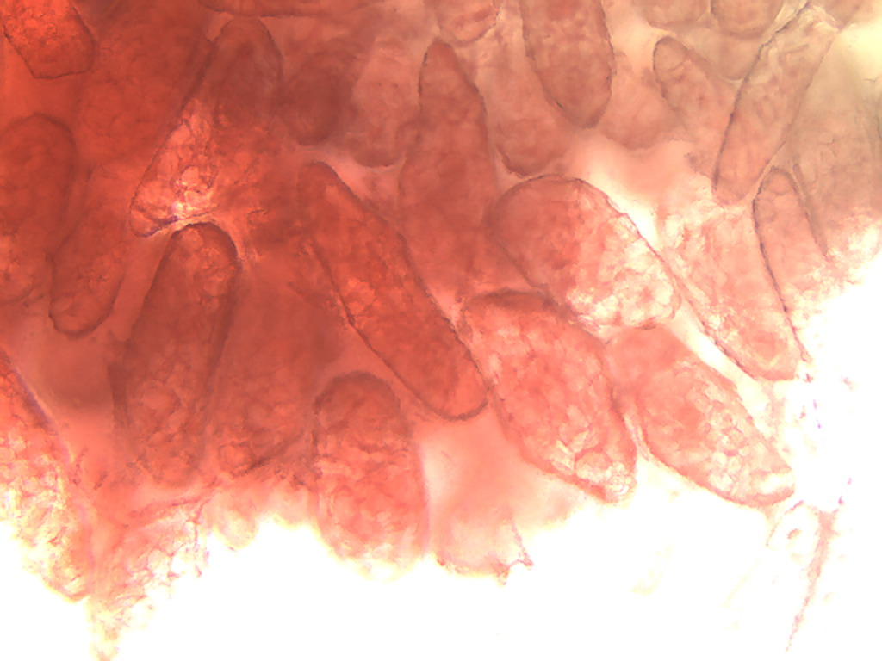
Notes:
41. Cicer arietinum L. Bean, garbanzo (= chickpea). Pulp parenchymal cells stained with safranin, 10X.

Slide 3
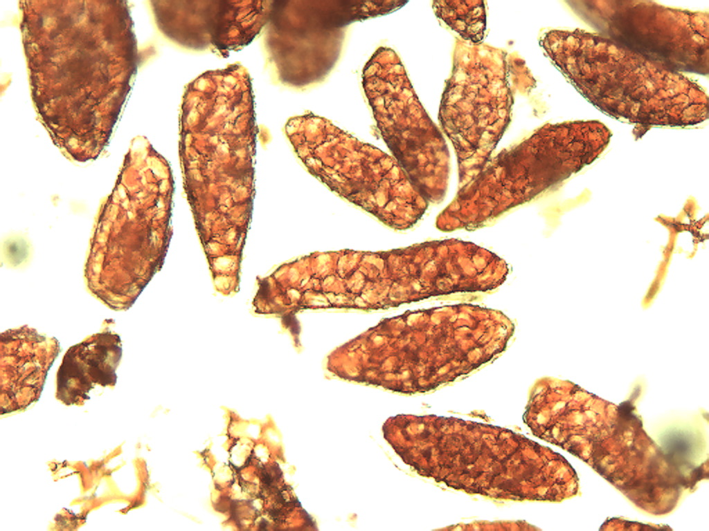
Notes:
42. Bean, garbanzo. Pulp parenchymal cells stained with safranin, 10X.

Slide 4
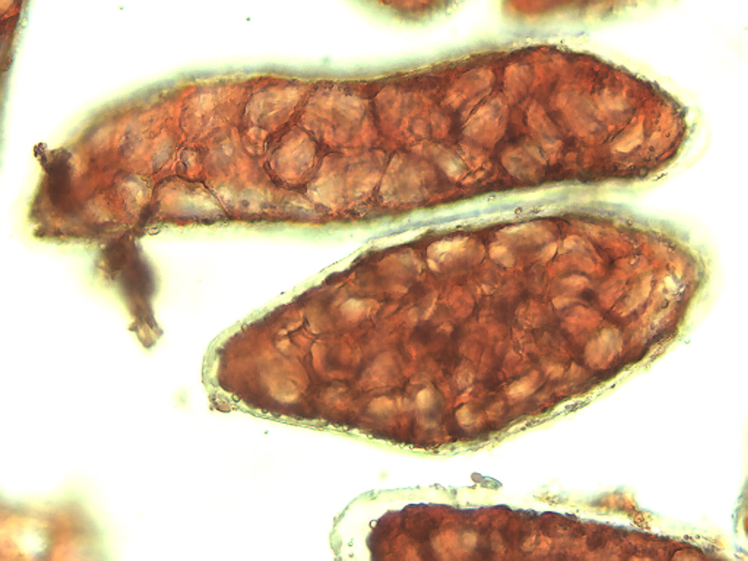
Notes:
43. Bean, garbanzo. Pulp parenchymal cells stained with safranin, 25X.

Slide 5
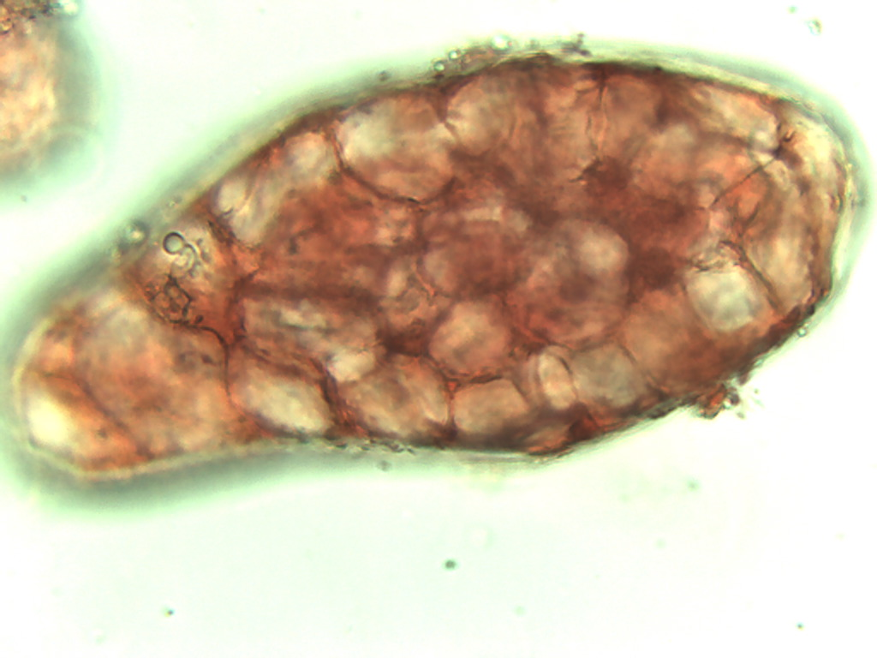
Notes:
44. Bean, garbanzo. Pulp parencyhmal cell stained with safranin, 40X.

Slide 6
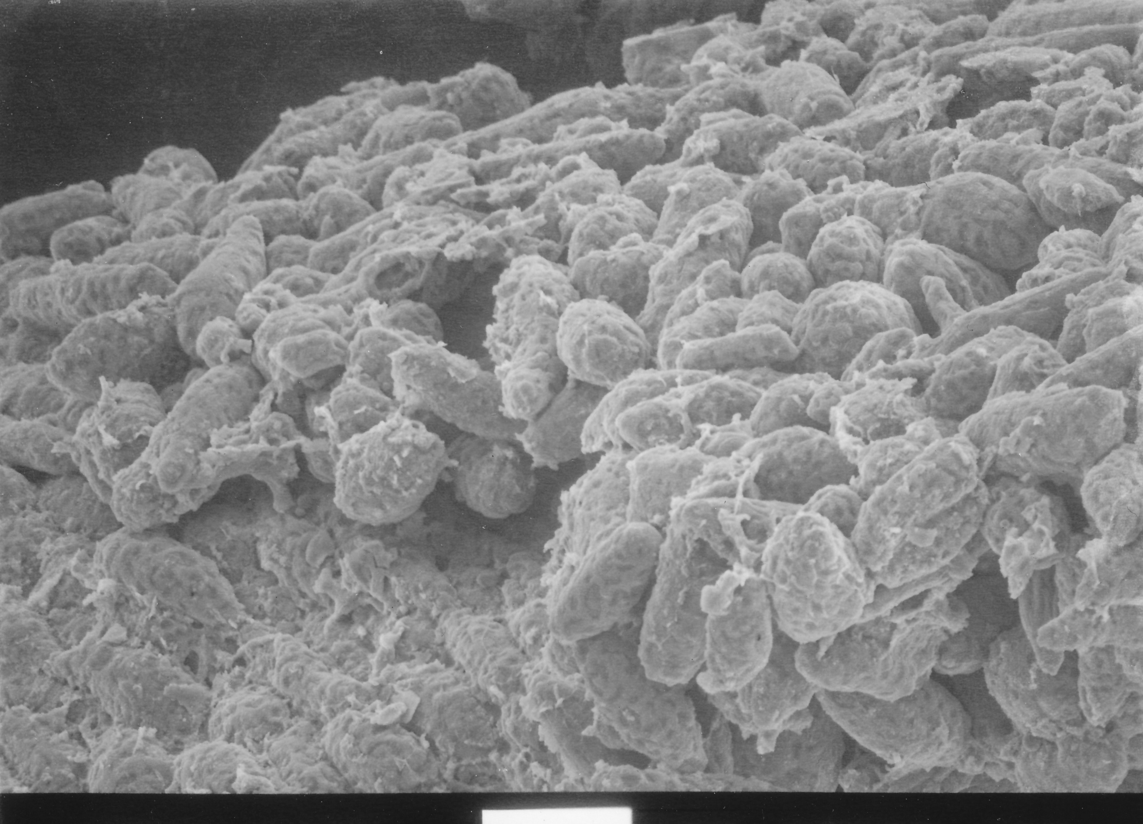
100 µm
100µm
Notes:
45. Bean, garbanzo. SEM of pulp parenchymal cells. SEM courtesy of Dr. Meredith A. Lane.

Slide 7
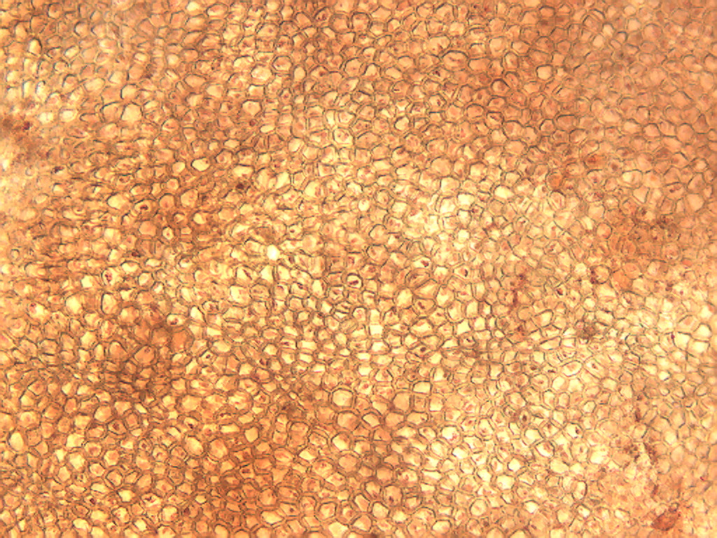
Notes:
46. Bean, garbanzo. Seed coat (testa) outer layer, stained with safranin, 10X.

Slide 8
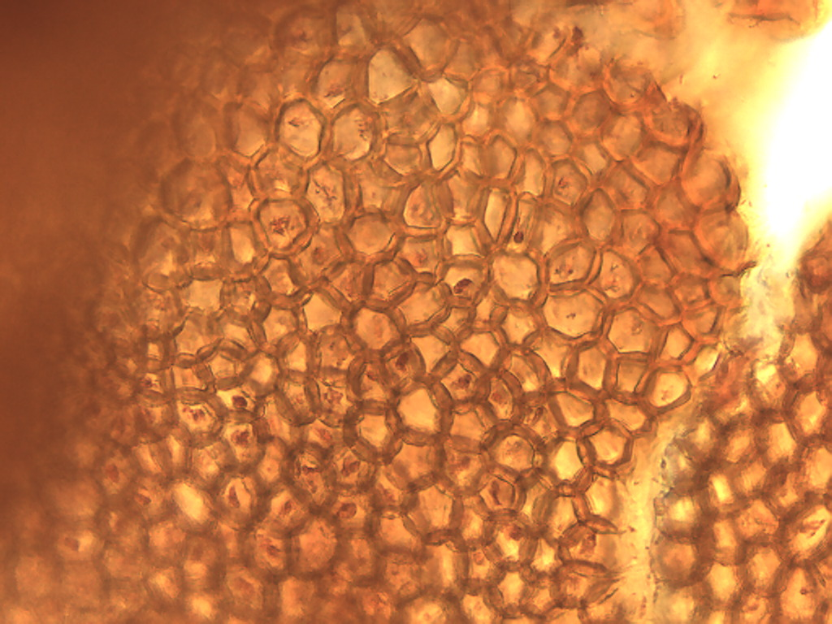
Notes:
47. Bean, garbanzo. Testa (seed coat). Outer layer stained with safranin, 25X.

Slide 9
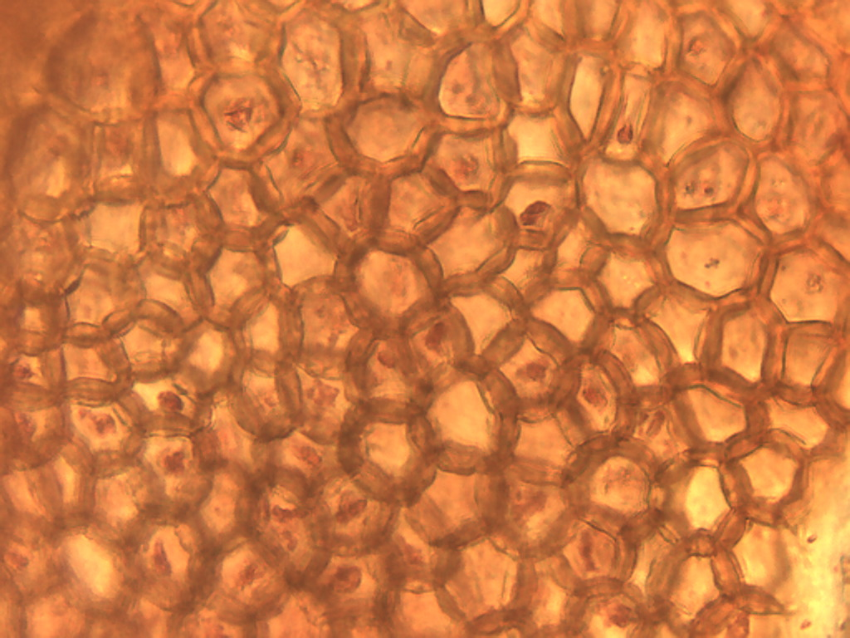
Notes:
48. Bean, garbanzo. Testa. Outer layer stained with safranin, 40X.

Slide 10
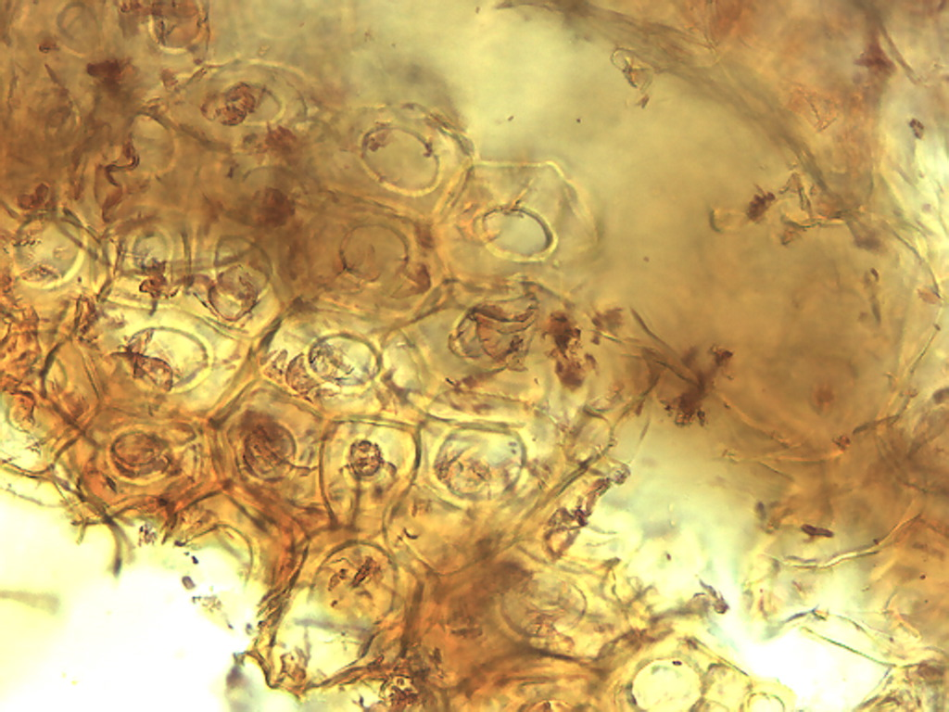
Notes:
49. Bean, garbanzo. Seed coat (testa). Second layer stained with safranin, 25X.

Slide 11
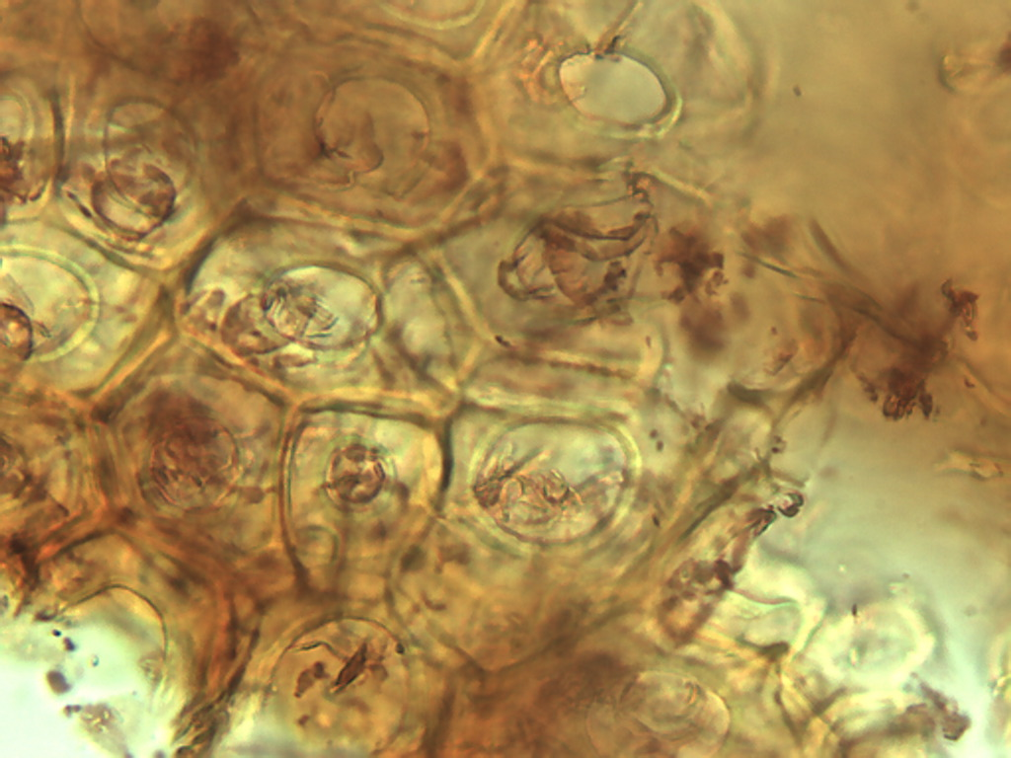
Notes:
50. Bean, garbanzo. Testa. Second layer stained with safranin, 40X.

